Slide 1

Azerbaijan Technical University
FREELANCE WORK
Student: Abdullayev Miryusif
Faculty: Information and telecommunication technologies
Group: 6224e
Specialty: İnformation Technologies
Academic year: 2024/2025
Subject: Data structure and algorithms
Teachers: Quluzadə Dilarə
Topic of the Freelance work:Data sorting algorithms

Slide 2
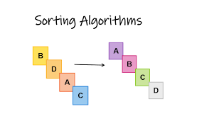
Introduction to Sorting Algorithms
Sorting algorithms are fundamental in computer science. They are used to rearrange data into a specific order—either ascending or descending. Efficient sorting improves the performance of other algorithms, such as search and merge operations, and is essential for processing large datasets.

Slide 3
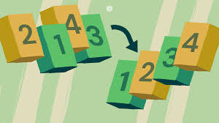
Why Sorting is Important ?
Sorting makes data easier to analyze and visualize. It helps with tasks like searching, duplicate removal, and data compression. The choice of sorting algorithm can significantly affect the time and space efficiency of software systems.

Slide 4
Bubble Sort
Bubble Sort is a simple algorithm that repeatedly steps through the list, compares adjacent elements, and swaps them if they are in the wrong order. Though it is easy to implement, it is inefficient for large datasets due to its O(n²) time complexity.

Slide 5
Selection Sort
Selection Sort divides the input list into a sorted and unsorted region. It repeatedly selects the minimum (or maximum) element from the unsorted part and moves it to the sorted region. Like Bubble Sort, it also runs in O(n²) time.

Slide 6
Insertion Sort
Insertion Sort builds the sorted list one element at a time by comparing each new item with those already sorted and inserting it into the correct position. It performs well on small or nearly sorted data sets.

Slide 7
Merge Sort
Merge Sort is a divide-and-conquer algorithm. It divides the input array into halves, recursively sorts them, and then merges the sorted halves. It guarantees a time complexity of O(n log n) and is stable, making it reliable for larger data sets.

Slide 8
Quick SortT
Quick Sort selects a 'pivot' element and partitions the array into two groups—those less than and greater than the pivot. These groups are sorted recursively. Although its worst-case time is O(n²), it is often faster than Merge Sort in practice.

Slide 9
Heap Sort
Heap Sort uses a binary heap data structure to sort elements. It converts the list into a heap and repeatedly extracts the largest (or smallest) element. Its time complexity is O(n log n), but it is not stable and often slower than Merge or Quick Sort.

Slide 10
Counting Sort
Counting Sort is an integer sorting algorithm that counts the occurrences of each value. It works well when the range of input data (k) is not significantly greater than the number of elements (n), achieving linear time O(n + k).

Slide 11
Radix Sort
Radix Sort processes each digit of the numbers from least significant to most significant. It uses a stable sub-sorting algorithm at each step. This makes it efficient for fixed-length integers and other structured data.

Slide 12
Bucket Sort
Bucket Sort distributes elements into several 'buckets' based on a hash or range, and then sorts each bucket individually. It is effective when input data is uniformly distributed and performs best with a good internal sort.

Slide 13
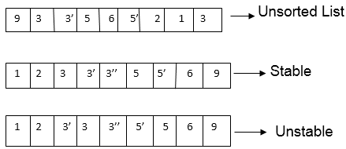
Stable vs Unstable Sorts
Stability in sorting algorithms means that equal elements retain their original relative order. Stable sorts are important when sorting complex records. Examples: Merge Sort is stable; Quick Sort is not.

Slide 14
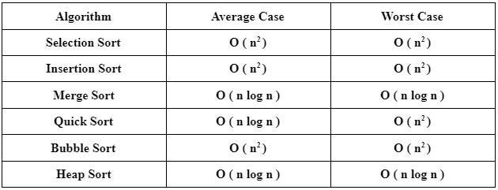
Comparison of Sorting Algorithms
Comparison of Sorting AlgorithmsText:Sorting algorithms are compared based on time complexity, space usage, stability, and implementation difficulty. No single algorithm is best for all situations. Choosing the right one depends on the data and application.

Slide 15

Real-World Applications
Sorting algorithms are used in search engines, databases, artificial intelligence, e-commerce, data visualization, and more. They are part of the core tools of any data processing system.

Slide 16
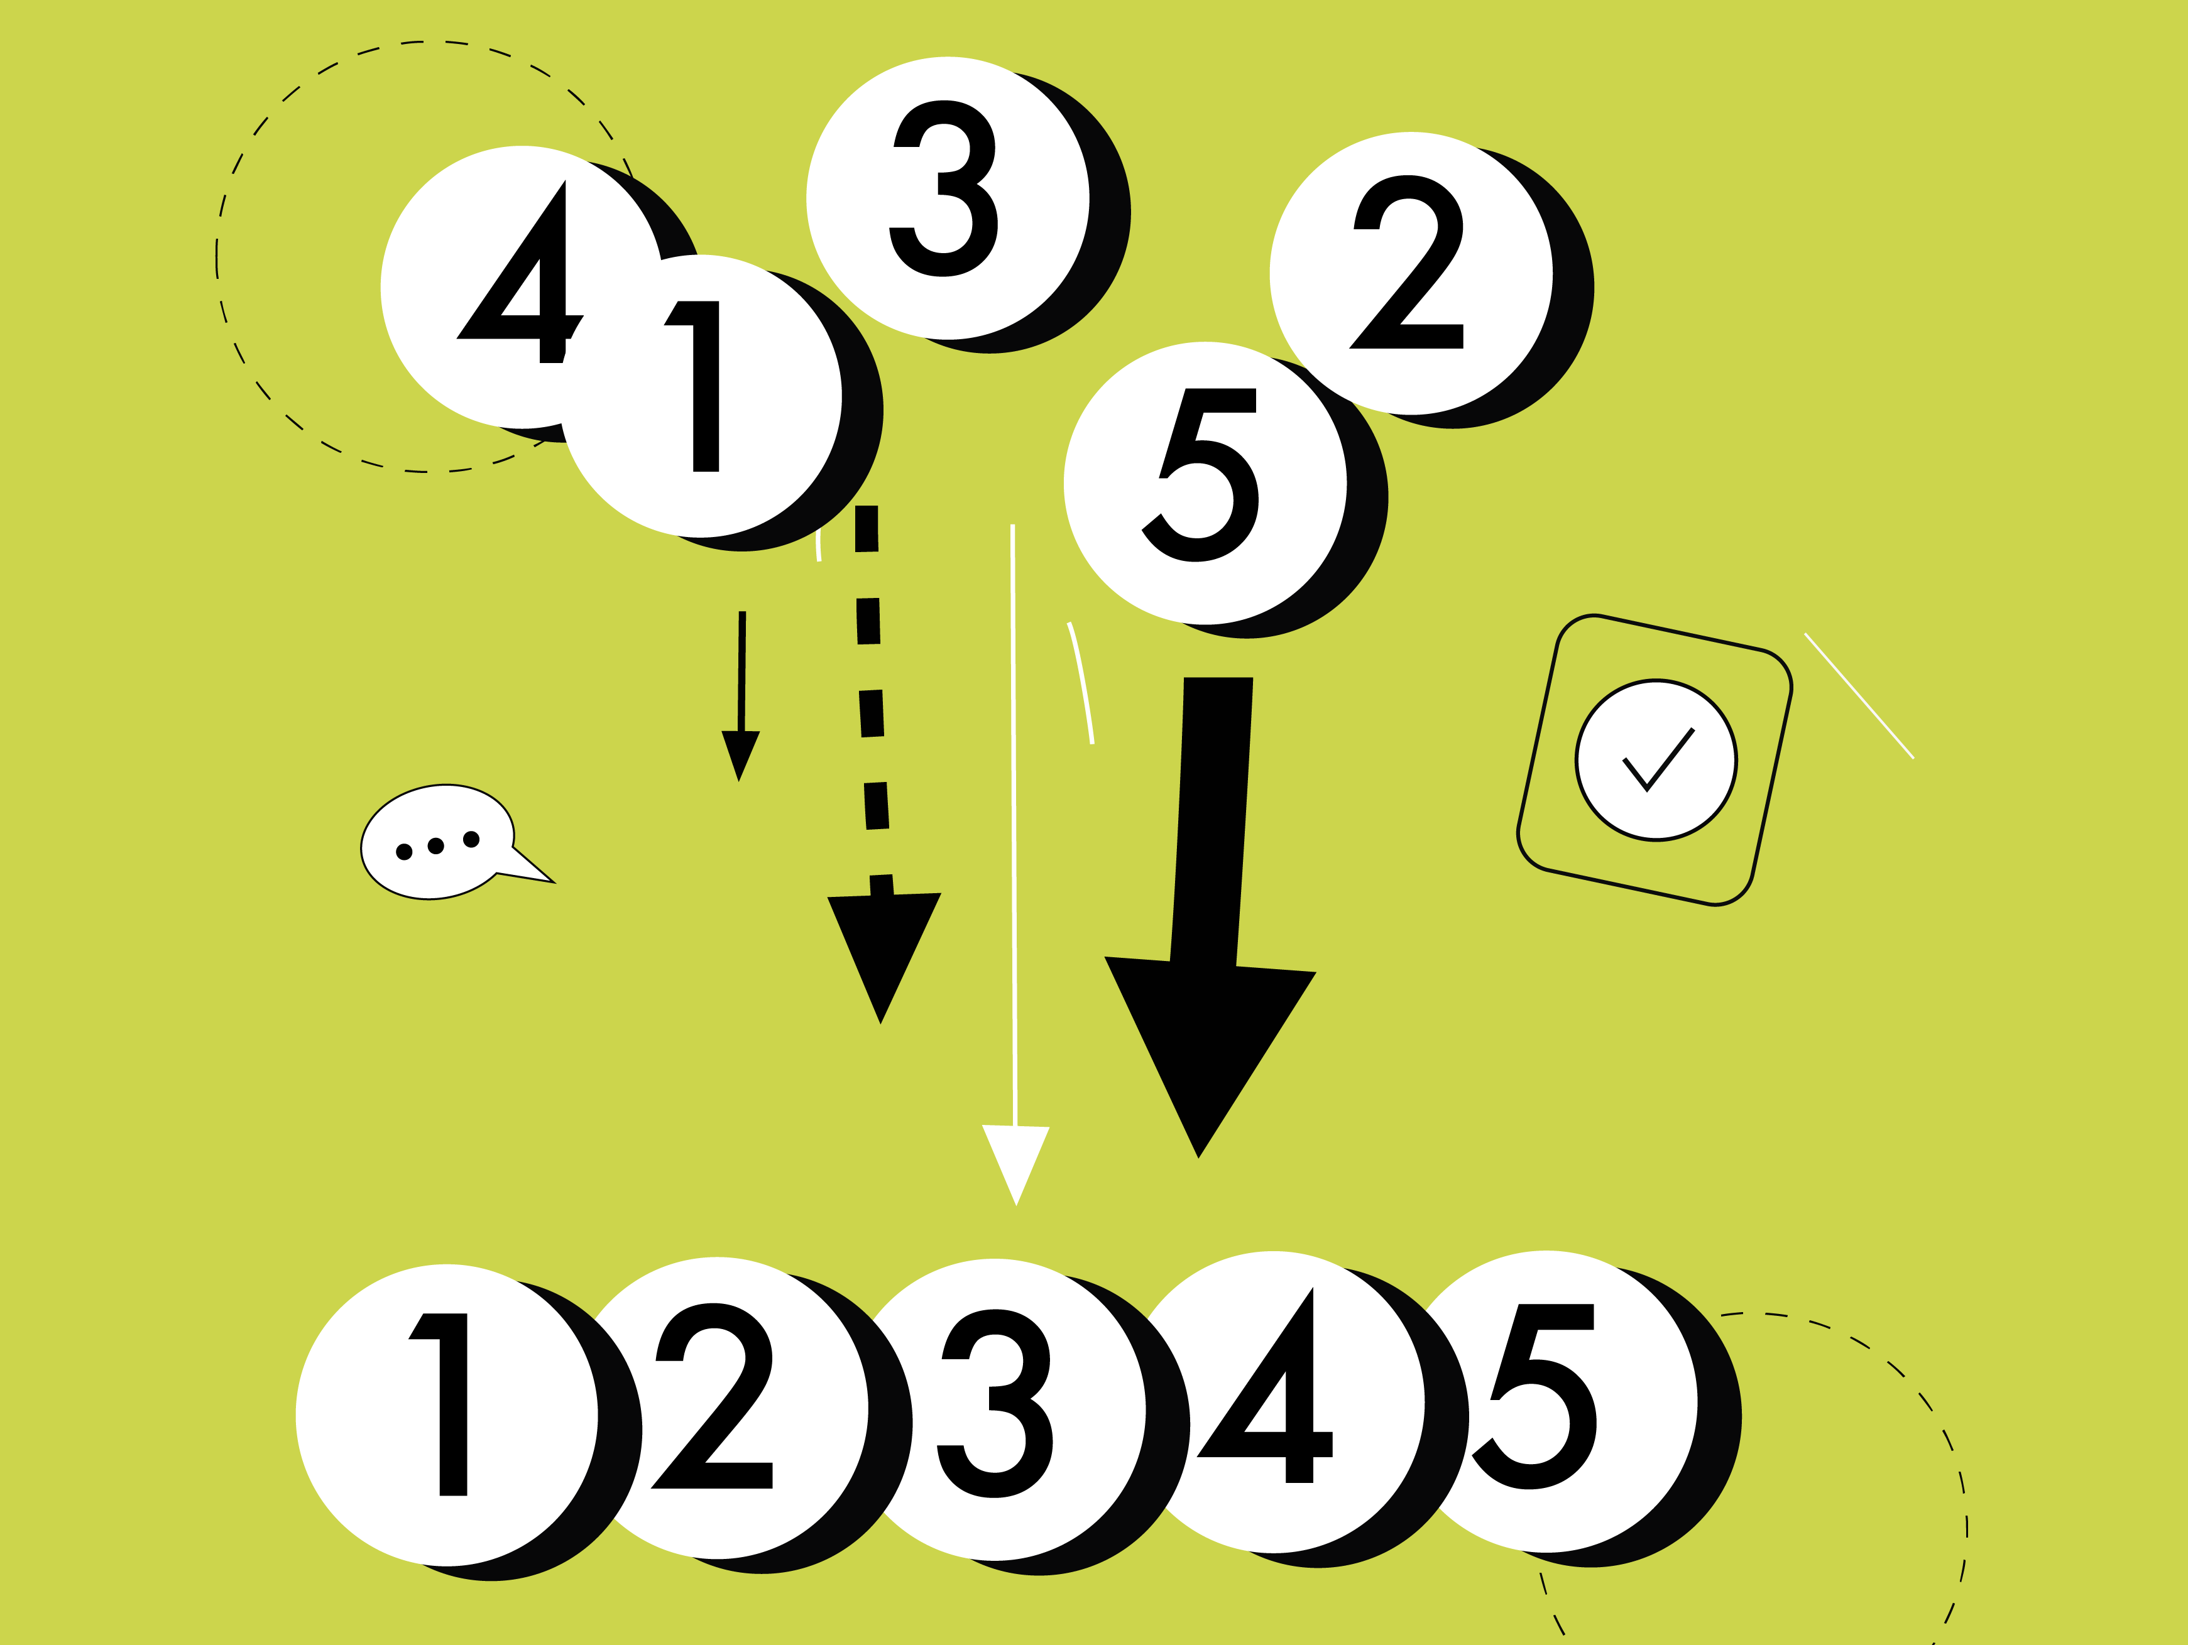
Conclusion
Understanding sorting algorithms helps developers write faster and more efficient programs. Whether it's a simple Bubble Sort or a complex Quick Sort, each algorithm plays a crucial role in computing.

